Slide 1
Predicting auction sale prices for Bulldozers
Machine Learning Project 3
By
Zvika Barak
March 2021

Slide 2
The Data Set
Source: Kaggle 2013 competition :
first prices $6,500
second price $3,500
third price $1,000
The project used the training set (Train.csv) containing more than 400,000 records with 53 columns (features)
Explanation | Field Names
Unique identifier of the sale | SalesID
Unique identifier of a machine. A machine can be sold multiple times | MachineID
The price the machine sold for at auction | SalePrice
The date of the sale | saledate
 | ModelID
 | YearMade
Compact, Mini, Small, Medium, Large/Medium, Large | ProductSize
Various bulldozer characteristics such as DriveSystem, Forks, ProductGroup, Pad_type and more. | + 46 Fields

Slide 3
Cleaning
Using info() revealed : 21 features with less than 80,000 non nulls (20% of the total).
Inner join with another set that had 16 more features, some of them identical to the one. Dropping the duplicate features and those with less than 20% non nulls, yielded a final set of 36 features.
Type int are 6 features , 4 type float, rest are object.
Loaded a subset of 30,000 records as the working set.
Wrote a transformer to convert saledate to int with number of days since 01.01.1900
Printed value counts of all object features and found out they are categorical features.

Slide 4
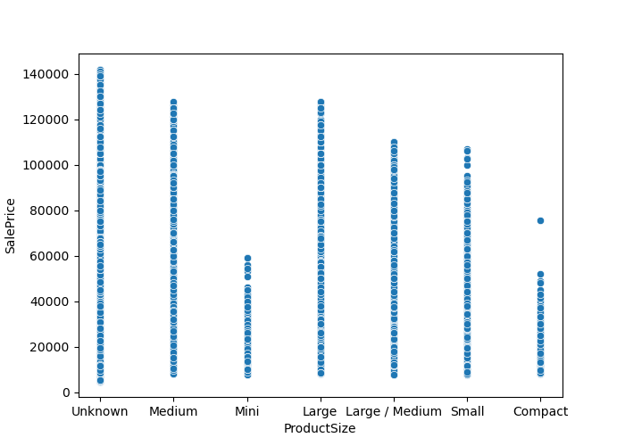
Cleaning – cont…
Plot scatter plot of price by Product Size to determine proper order category compact. It is more than Mini but less than Small.
Wrote a transformer set category to convert this feature based on the order of ['Mini', 'Compact', 'Unknown', 'Small', 'Medium', 'Large / Medium', 'Large'], filling nulls = 3 (Unknown) = mean().

Slide 5
Cleaning – cont…
Generalized that set category transformer to convert any given feature to numeric based on it’s value counts or a list of user-defined list (such as for the Product Size feature, and filling nulls, taking care of any type of null (Nan, None, None or Unspecified, No) or any combinations of them (some features had multiple type of nulls).
Wrote a transformer to act on the 4 float features, filling nulls as 0 and removing 6-sigma rows.
Noticed that 3 of these float features were non continuous such as MfgYear and AuctionerID. Wrote a transformer to normalize the 4th feature MachineHoursCurrentMeter based on norm ‘l2’ (sqrt(sum(val**2)).
Wrote a transformer to downcast the numeric fields from float64/int64 to 32/16/8 types to reduce memory and increase efficiency in calculations.
Left with 26,431 rows (88%)

Slide 6
Cleaning – cont…
All transformers collected into a pipeline to be used automatically over & over:
pipeline = Pipeline([
('days', FunctionTransformer(get_sales_days)),
('cat_ProductSize', FunctionTransformer(set_category, kw_args={'disp': False,
'cols': ['ProductSize'], 'fillna':['Unknown'],
'cats': ['Mini', 'Compact', 'Unknown', 'Small', 'Medium', 'Large / Medium', 'Large']})),
('cat', FunctionTransformer(set_category, kw_args={'disp': False,
'cols': ['state','Enclosure','Forks','Ride_Control','Transmission','Hydraulics','Ripper', 'Tire_Size‘,'Coupler','Track_Type','Undercarriage_Pad_Width‘, 'Stick_Length‘, 'Thumb', 'Pattern_Changer','Grouser_Type','fiModelDesc_ma','fiBaseModel_ma', 'fiSecondaryDesc_ma', 'fiProductClassDesc_ma‘,'ProductGroup_ma', ‘ ProductGroupDesc_ma','fiManufacturerDesc','PrimarySizeBasis'],
'fillna':[0,0,'None or Unspecified','No|None or Unspecified','None or Unspecified', 'None or Unspecified','None or Unspecified','None or Unspecified‘, 'None or Unspecified', 0,'None or Unspecified','None or Unspecified','None or Unspecified','No|None or Unspecified',0,0,0,0,0,0,0,0,0]})),
('cat_Drive_System', FunctionTransformer(set_category, kw_args={'disp': False, 'cols': ['Drive_System'], 'switch': [2, -1], 'reverse': True})),
('set_six_sigma', FunctionTransformer(six_sigma, kw_args={'disp': True})),
('col_normalizer', FunctionTransformer(col_normalizer, kw_args={
'cols': ['MachineHoursCurrentMeter'], 'norm':'l2'})),
('numeric', FunctionTransformer(convert_numeric))
], verbose=True)
df = pipeline.fit_transform(df)

Slide 7
Cleaning – cont…
Run all 4 models on the dataset (price non logartimic) with the following rmsle results :
0.2716 RadomForest
0.3670 DT
0.6214 KNN
1.0026 Linear
The Kaggle criteria was for the lowest rmsle
RadomForest gave the best result. That was the model I chose.

Slide 8
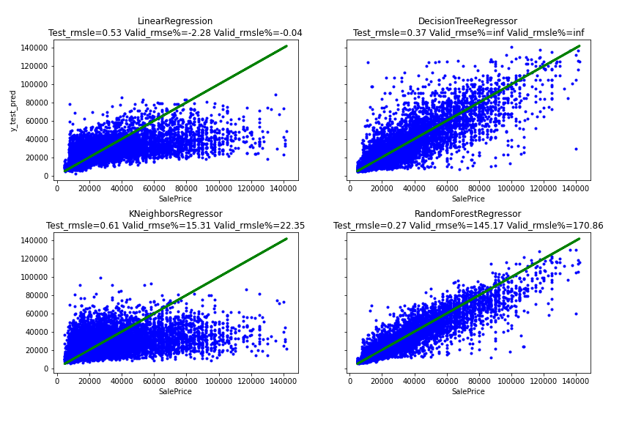
Cleaning – cont…

Slide 9
RandomForest – Take1
Tested all 4 models on the log of the price and all models improved (as can be seen on the previous slide which is the output of log_price, and the result is part of the title): RF model rmsle down to 0.2658
Checked the correlation map and found out that 4 features had correlation of 0.8 and higher between themselves, but not with SalePrice.
After dropping them the model improved to 0.2570.
Thus the model was left with 32 features.
However, the valid.rmsle% was 170%
model not valid

Slide 10
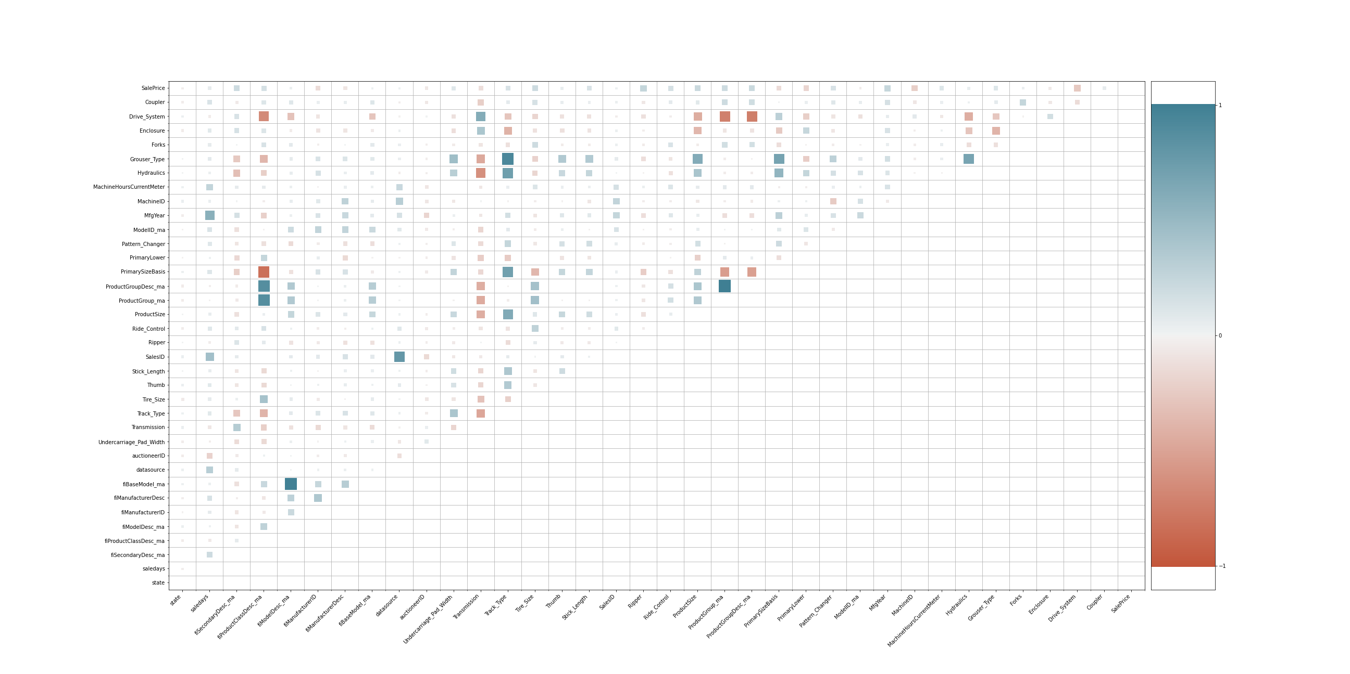
RandomForest – Take 1
Correlation Map

Slide 11
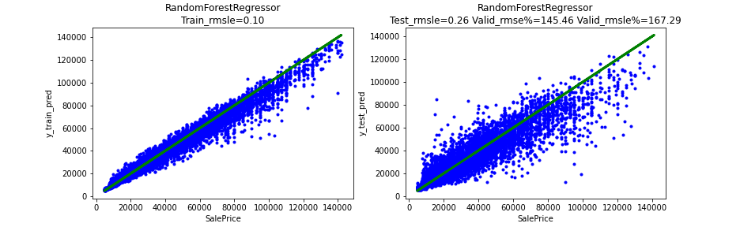
RandomForest – Take1
ML = ml.run_model(df, disp=True,
col='SalePrice', ratio_col=None, is_log_scale=True, plot=True, model_num=ml.randomForestRegressor, png_path=“plot.png", disp_path=“df.png")

Slide 12
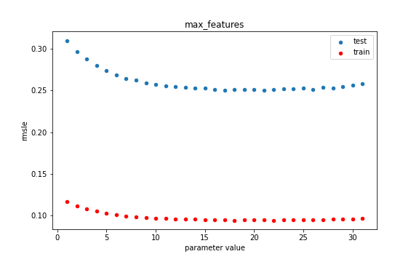
RandomForest – Take 2
Trying to find best hyper-parameter.
Performed Regularization to improve model validity
First hyper-parameter checked: max_features, all values from 1 to 31.
MAX_FEATURES = 17 best result: rmsle=0.2507 but valid=165%

Slide 13
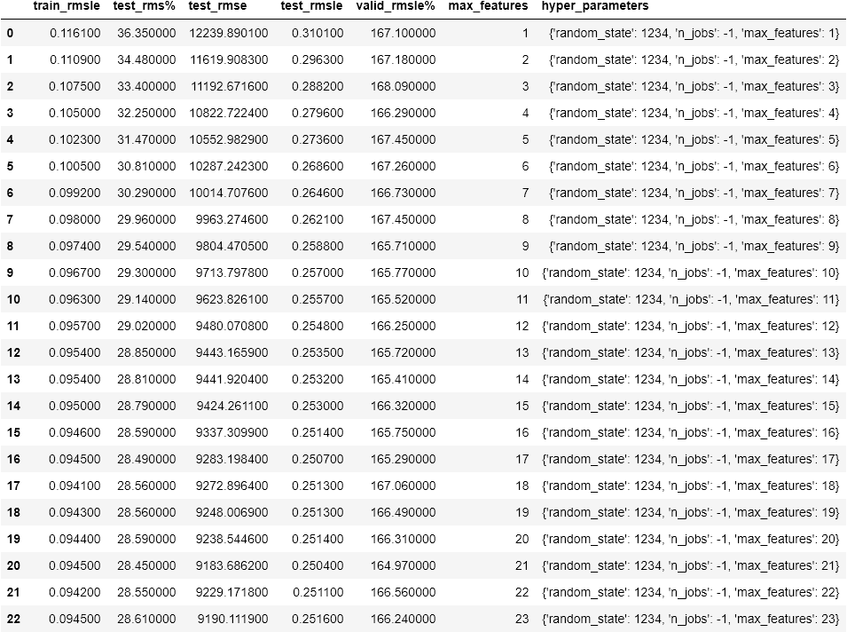
RandomForest – Take 2

Slide 14
RandomForest – Take 2 cont...
Other hyper-parameters checked gave the best results for:
(need to balance between rmsle an valid)
min_samples_split = 11
n_estimators = 200
max_features = 19
max_leaf_nodes = None (default)
min_samples_leaf= 1 (default)
bootstrap = True (default)
max_depth = None (default)
hp_range = range(2, 31)
ml.hp_loop(df, disp=False,
model_num=ml.randomForestRegressor, hp_name = 'min_samples_split', hp_range=hp_range, is_log_scale=True, col='SalePrice', ratio_col=None, plot=True, png_path=“plot.png", disp_path=“data.png",
random_state=1234, max_features=17, n_jobs=1)

Slide 15
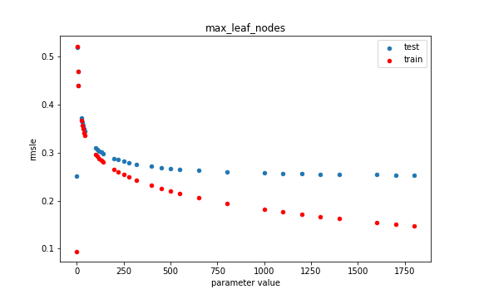
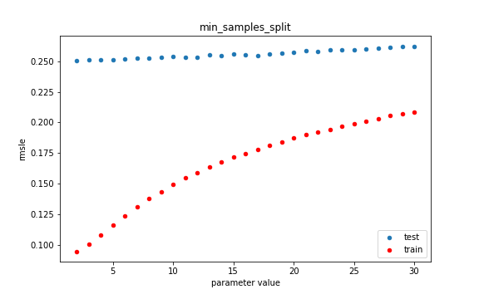
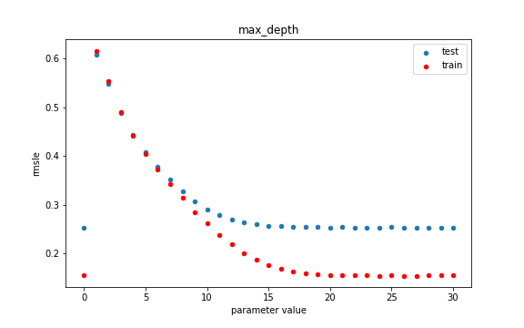
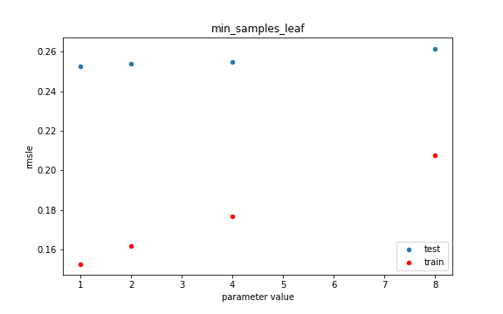
RandomForest – Take 2 cont...

Slide 16
RandomForest – Take 2 cont...
Best optimal result:
rmsle = 0.2514 valid = 65.5%
ML = ml.run_model(df,
col='SalePrice', ratio_col=None , is_log_scale=True, plot=False, disp=True, model_num=ml.randomForestRegressor, disp_path= "bulld_rf_df.png",
random_state=1234, min_samples_split=11,, max_features=19, n_estimators=200)

Slide 17
RandomForest – Take 3
Outliers – since we do not know much about bulldozers we looked at the value_counts of all 31 features and selected the outliers that were few compared to the others (eg. only 1 or 2 of that value compared to 30 and more for the others).
We identified 9 such features, checking the impact on the model after dropping rows for each feature. If the rmsle did not improve we did not use that feature.
At the end 3 features were used ['Enclosure', 'Transmission', 'Undercarriage_Pad_Width'] and a total of 1,096 rows were dropped out of 26, 437.
A transformer to remove the outliers was written and added to the pipeline.
Final best result:
rmsle = 0.2438 valid = 59%

Slide 18
RandomForest – Take 4
Final Steps – run the model on the full data set with 400,000 records.
First the on loading the columns that were dropped are not loaded.
Then the pipeline is applied to take care of the categories, normalize, saledate, 6-sigma and convert to numeric.
Memory usage went down from 97.9 MB for 401,124 records to 21.6 MB for 353,680 (78% less memory for 12% less records !!!).
The average sale price is 32,785 USD (32,775 for the 30,000 training set)
Surprise !
rmsle = 0.2092 valid = 62.5%

Slide 19
RandomForest – Take 5
Lastly, remove outliers and run again the model on the full data set.
Success!
rmsle = 0.2087 and valid = 62.7%
Remember we started with
rmsle = 0.2716 and valid = 142.5%
Our rmsle improved 23% with a valid model

